Slide 1
Electronics & Electricity
Unit 9 – What is arduino
Section 1 – What is arduino

Slide 2
What is Arduino
What is arduino

Slide 3
The big idea
Breadboard circuit prototyping
Applying code through Arduino IDE
Rapid prototyping
Code, electronics, and prototyping
Building models to test

Slide 4
Arduino

Slide 5
What is Arduino?
Arduino is an open-source electronics platform based on easy-to-use hardware and software
Arduino boards are able to read inputs - light on a sensor, a finger on a button, or a Twitter message - and turn it into an output - activating a motor, turning on an LED, publishing something online
You can tell your board what to do by sending a set of instructions to the microcontroller on the board
To do so you use the Arduino programming language (based on Wiring), and the Arduino Software (IDE), based on Processing

Slide 6
Why Arduino?
Inexpensive - Arduino boards are relatively inexpensive compared to other microcontroller platforms. The least expensive version of the Arduino module can be assembled by hand, and even the pre-assembled Arduino modules cost less than $50
Cross-platform - The Arduino Software (IDE) runs on Windows, Macintosh OSX, and Linux operating systems
Simple, clear programming environment - The Arduino Software (IDE) is easy-to-use for beginners, yet flexible enough for advanced users to take advantage of as well

Slide 7
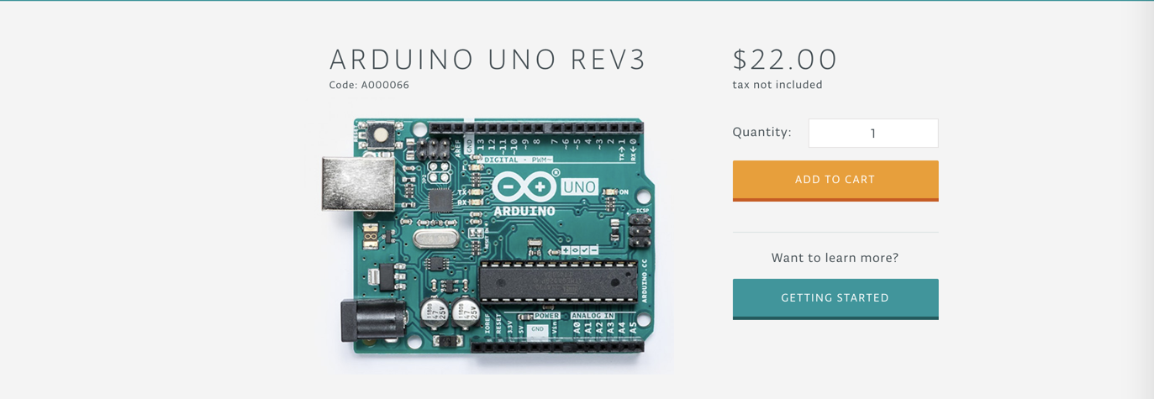
Our Arduino board

Slide 8
Getting started
Like the breadboards, we will first work in a virtual environment before moving to the physical components
TinkerCAD has a built-in Arduino environment able to code and experiment with
Our first Project, The Love Meter

Slide 9
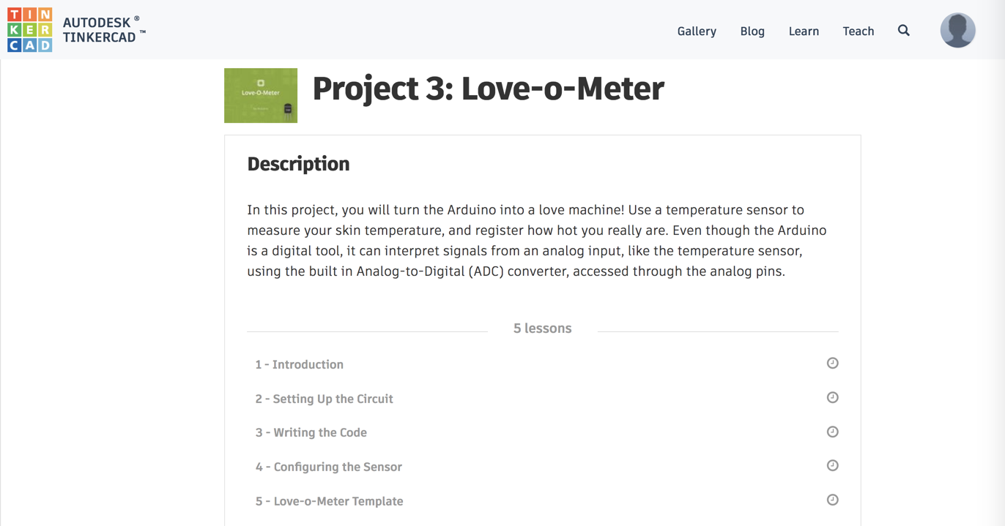
The Love Meter

Slide 10
The Love Meter
Begin the introduction lesson

